Slide 1
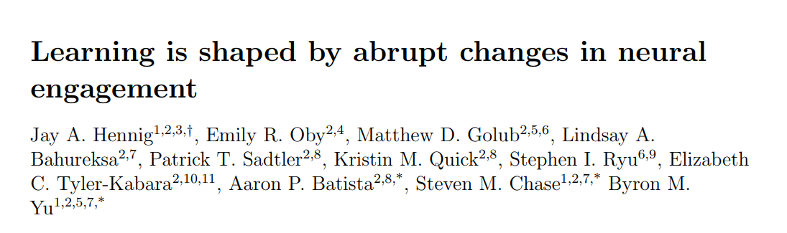

Slide 2
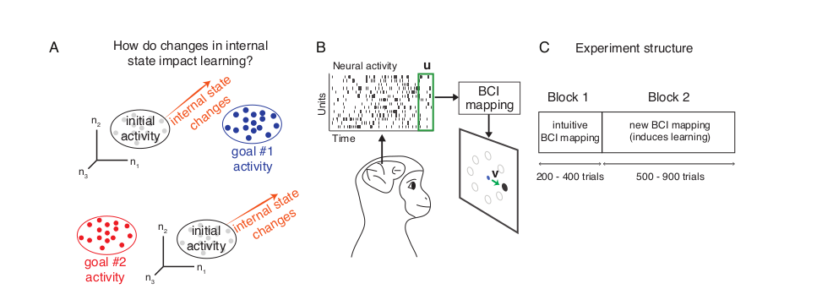
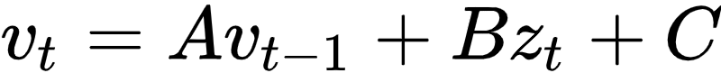

Slide 3
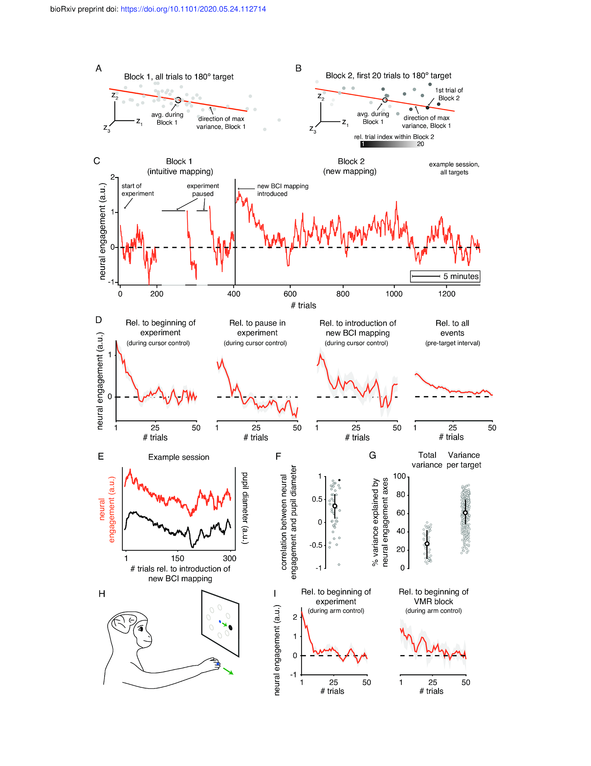
3 dimensions visualised, top 10 dimensions taken.

Slide 5
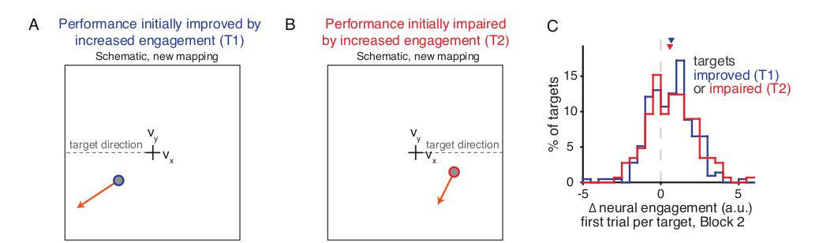
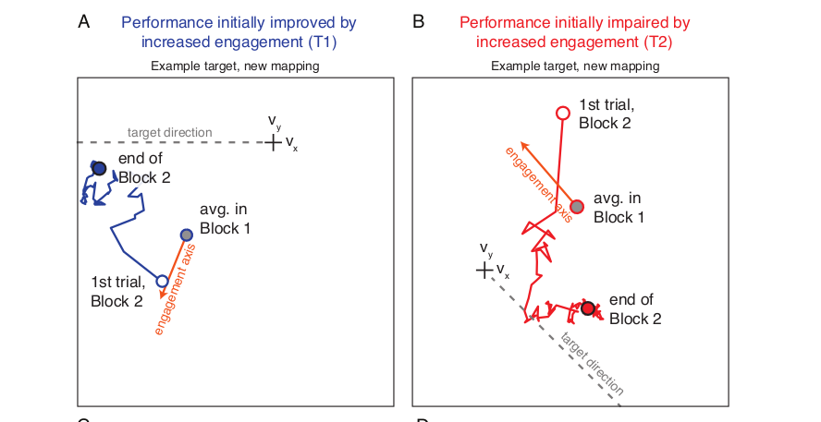
Neural activity increased along the neural engagement axes even if it affects performance negatively

Slide 6
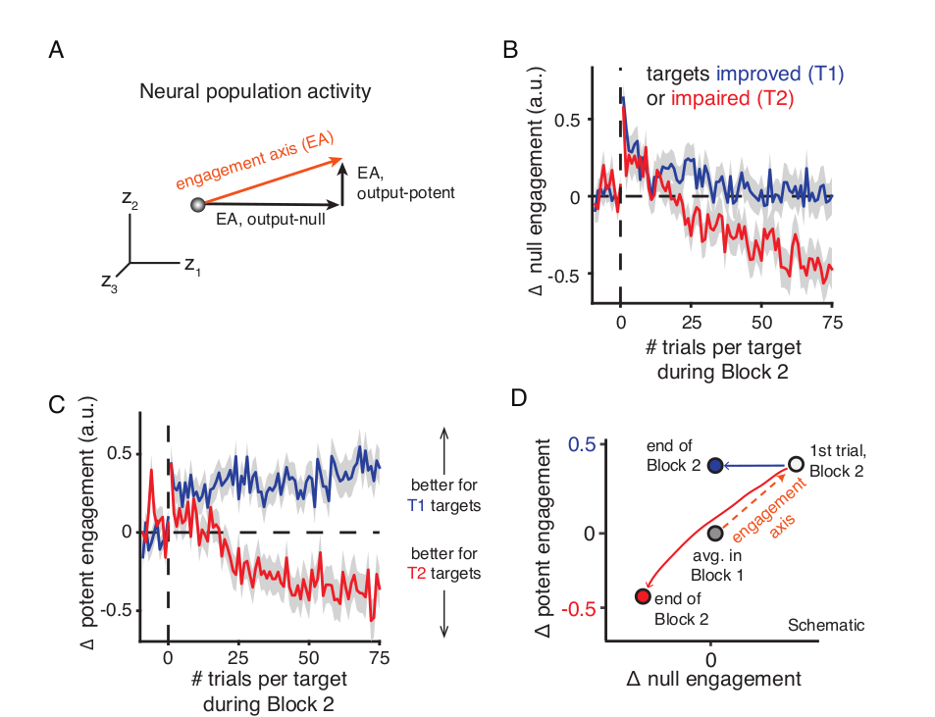
For T1, potent engagement did not change much while the decrease was mostly along null output-null
For T2, decrease was along both of them.
Some targets are easier to learn than others, while learning is impared for some tasks
Authors propose this signals may arise due to release of NE by the LC

Slide 7
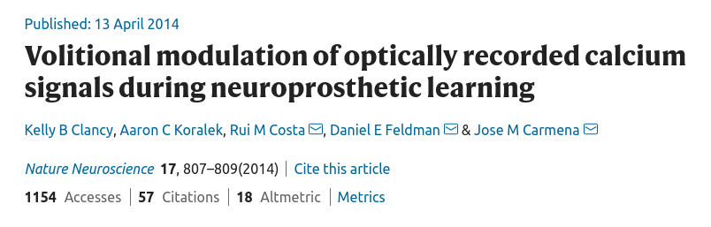

Slide 8
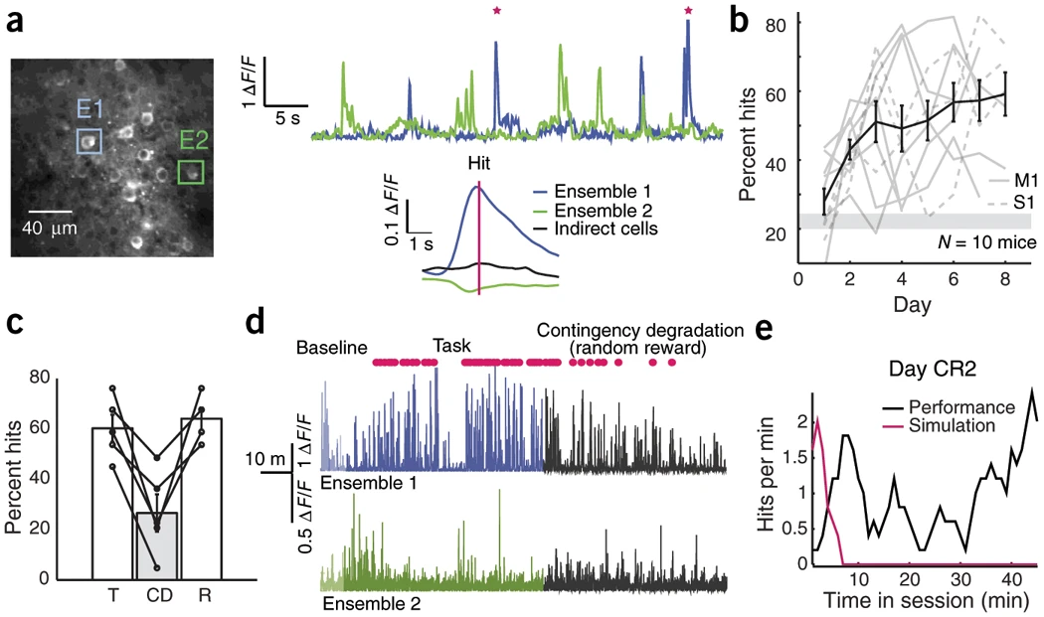
E1 and E2 oppose each other
Increased activity in E1 or decreased activity in E2 led to increase in pitch
Reward if pitch reached within 30s

Slide 9
E1 and E2 oppose each other
Increased activity in E1 or decreased activity in E2 led to increase in pitch
Reward if pitch reached within 30s
CD = contingency degradation, reward given randomly.
Contingency Reversal = rule for E1 and E2 reversed
Similar Dynamics for M1(N=7) and S1(N=3) animals

Slide 10
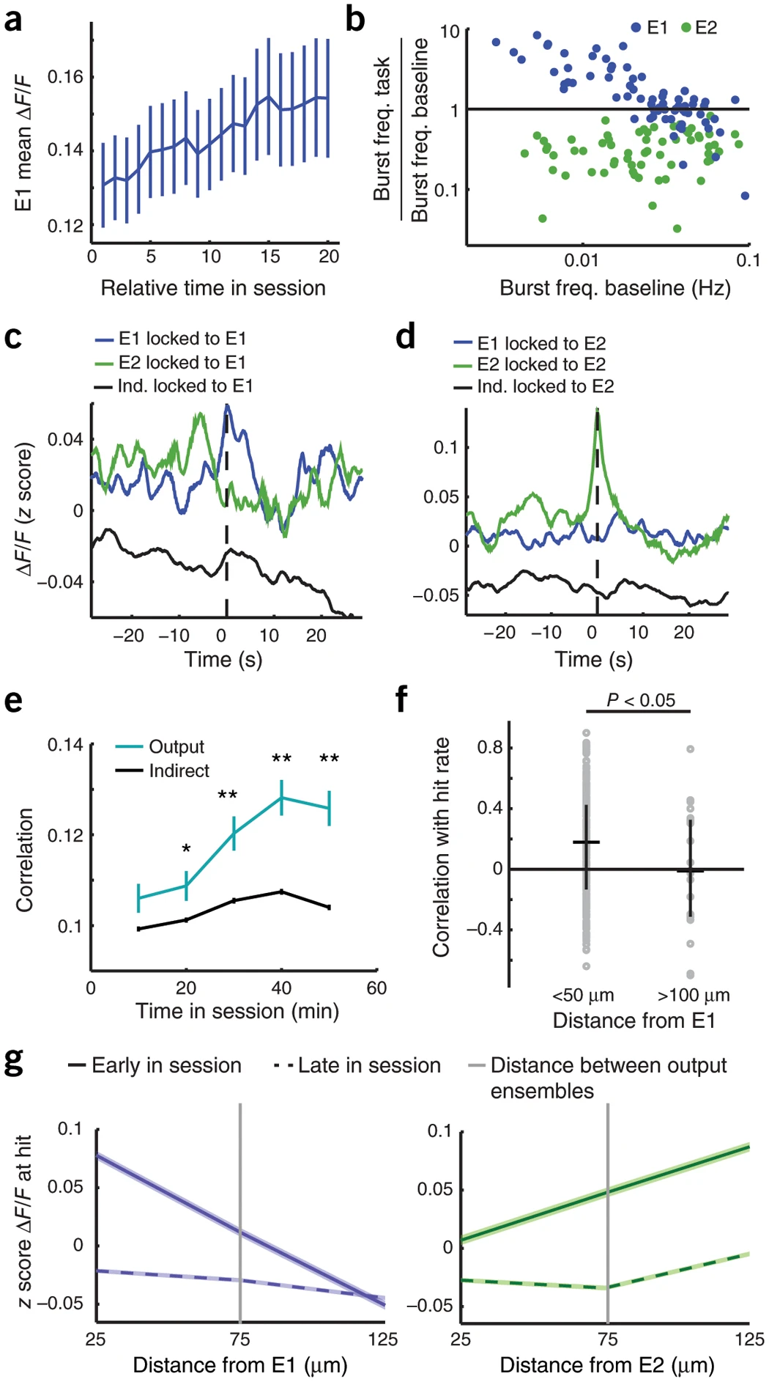
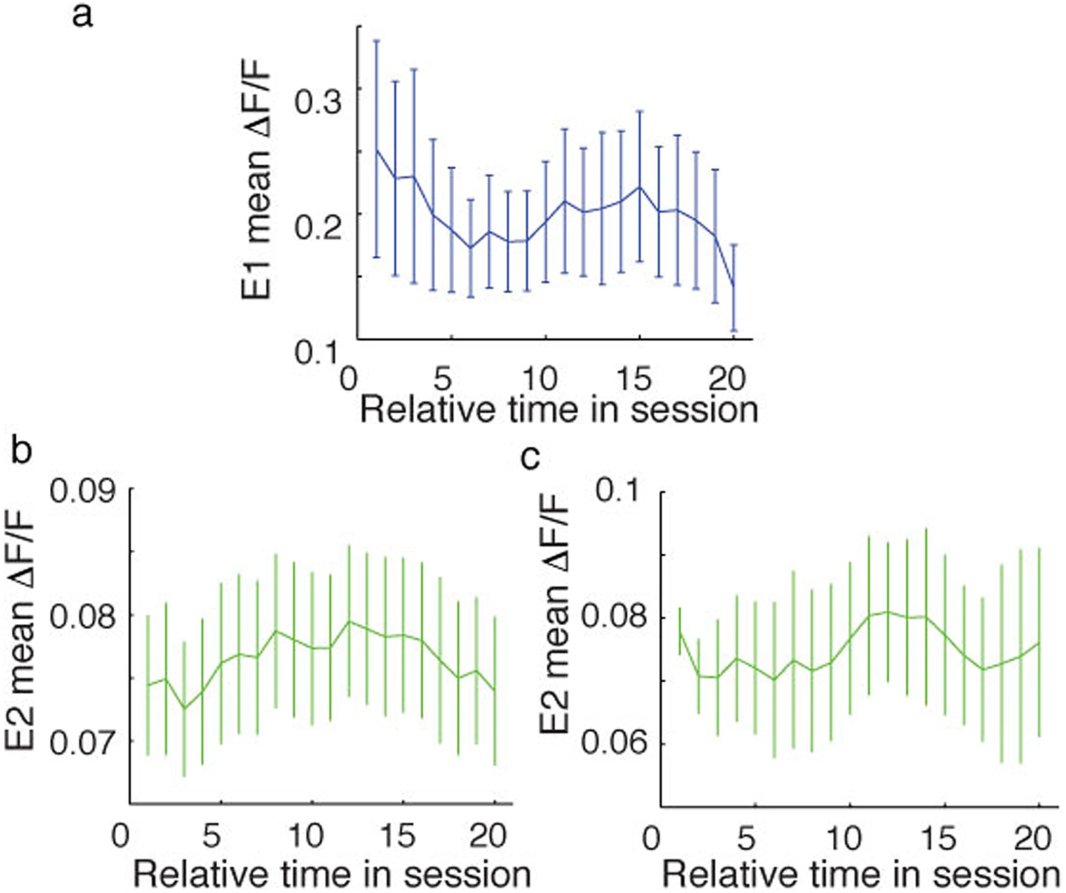
Left figures: Normal task
Right: Contingency degradation
Mean ΔF/F increased and decreased respectively during task and degradation in E1
Mean ΔF/F for E2 did not change significantly

Slide 11
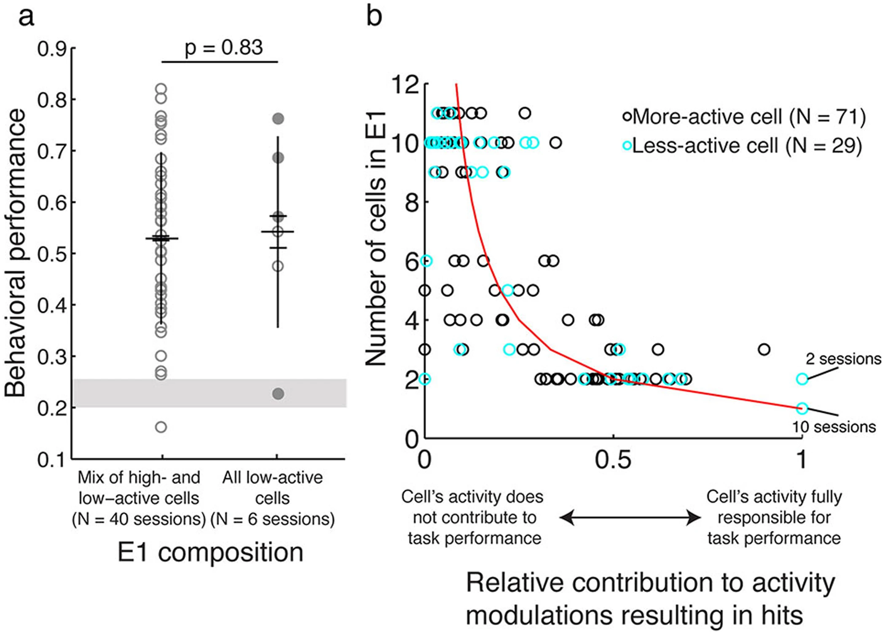
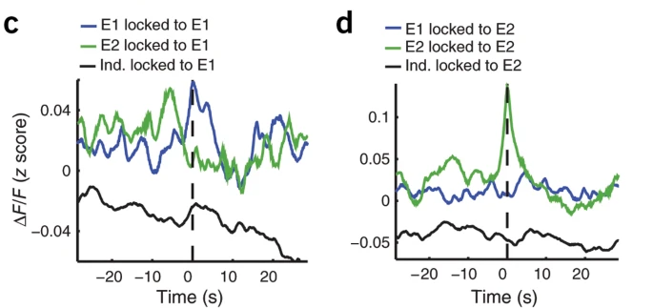
E2 developed a tendency to spike before E1
Performance not carried by single neuron

Slide 12
Correlations between output cells increased
Early in the session mice up modulate activity surrounding E1, later activity in indirect cells decrease
Baseline correlations affect performance

Slide 13
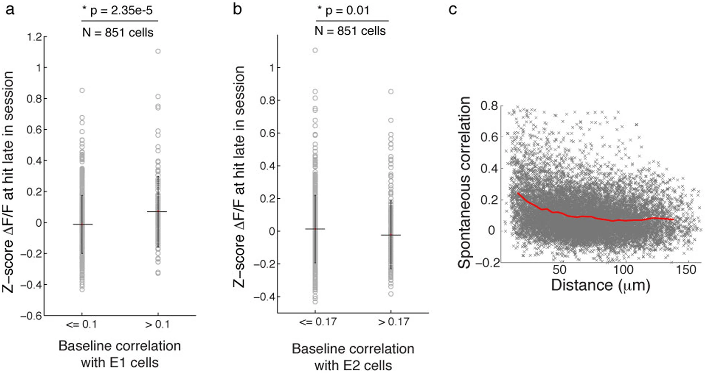
Increased correlation of functionally related cells during motor learning
Indirect cells that were initially correlated to E1 increased dynamics over the course of learning
Similarly for E2, they decreased activity
Mice performed better with fewer neurons. Suggests it was difficult to maintain control over large ensembles

